Slide 1







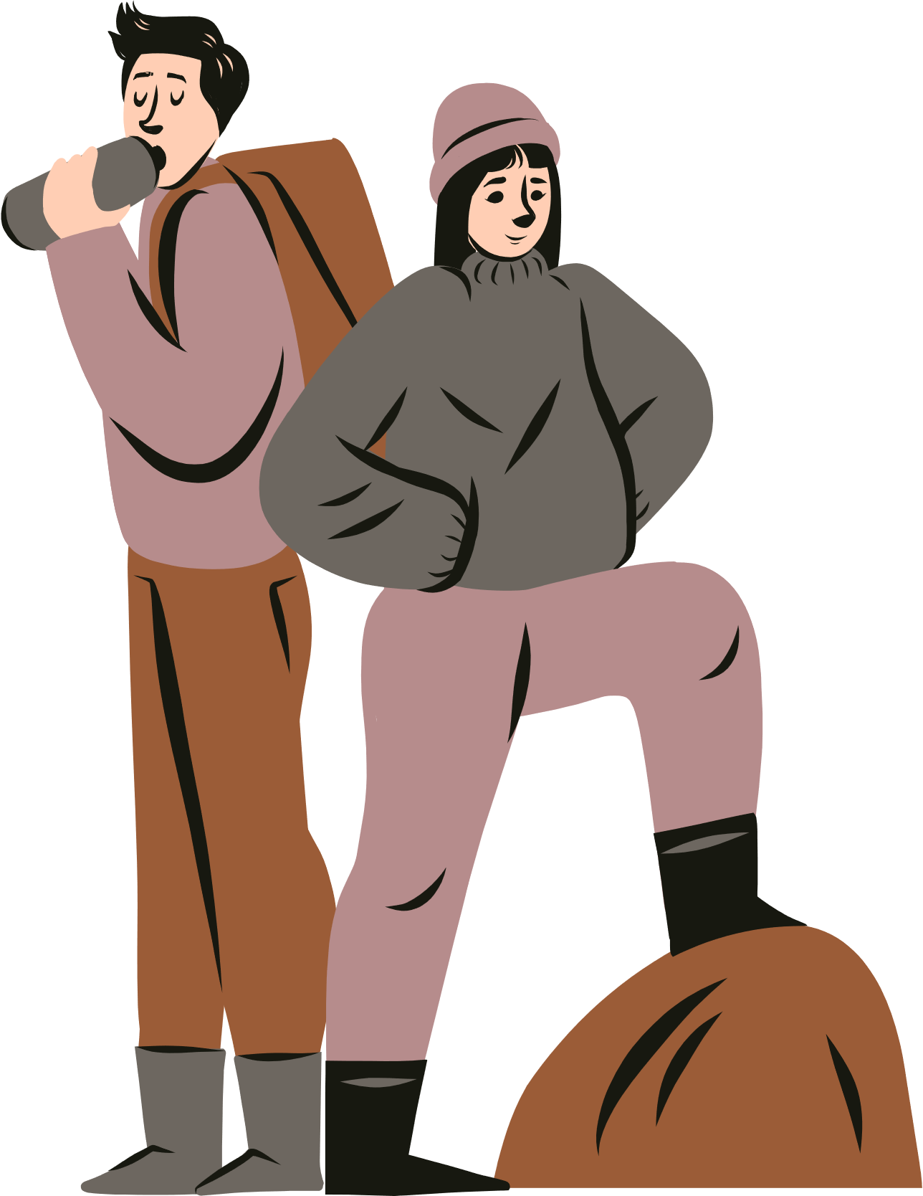
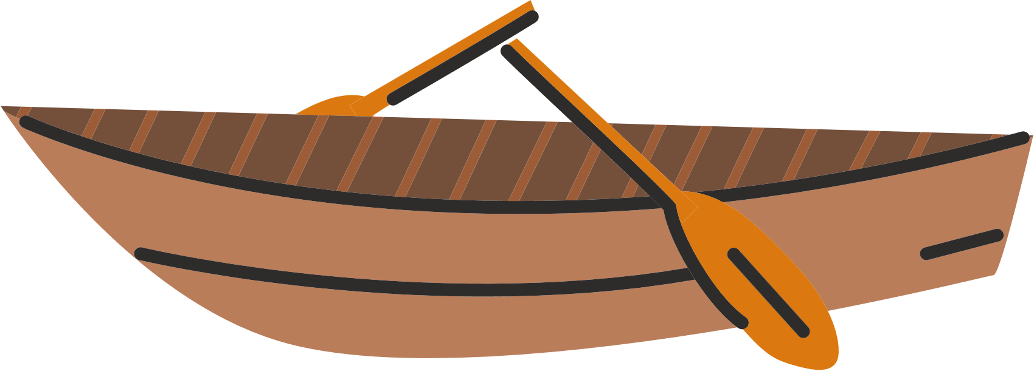


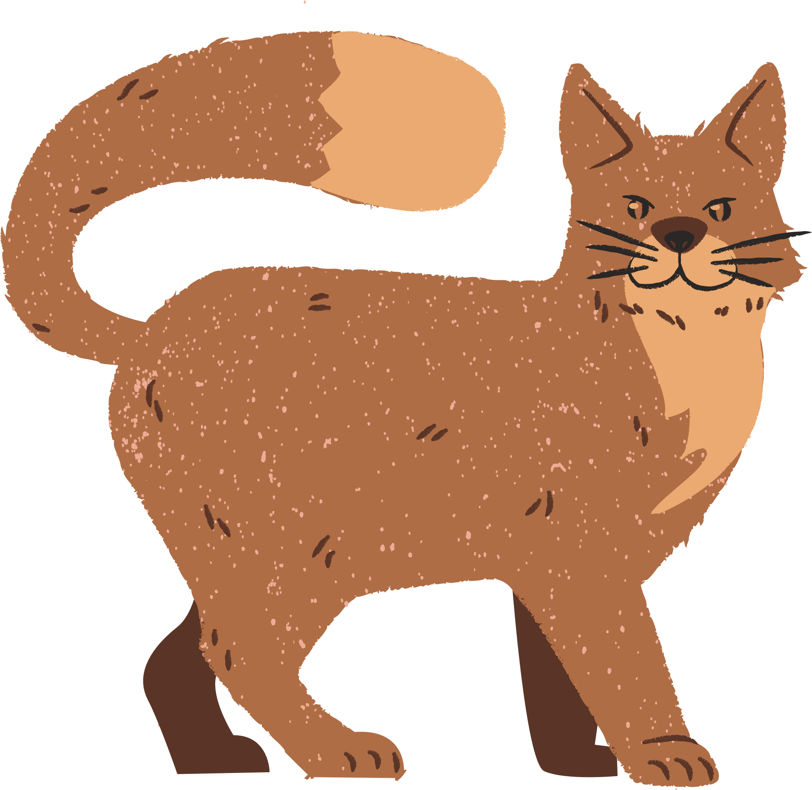
Phosphorus Footprint

Slide 2

A phosphorus footprint refers to the total amount of phosphorus that is used or consumed throughout the lifecycle of a product, service, organization, or individual, much like a carbon footprint.
It includes the phosphorus inputs associated with various activities, such as agricultural practices, industrial processes, and human activities.
This “footprint “ tool is a rough estimate of your activities and how they may affect the P cycle. It’s used to get us talking about this important issue.

Slide 3

How much do you think your P footprint affects the environment?
Let’s find out...
Use the scale for your responses (you may also use zero)

Slide 4
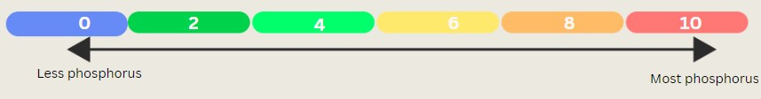
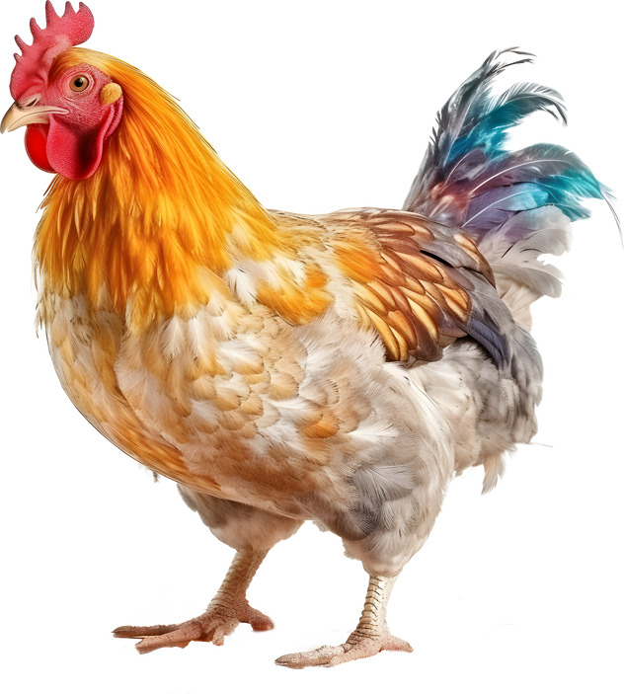
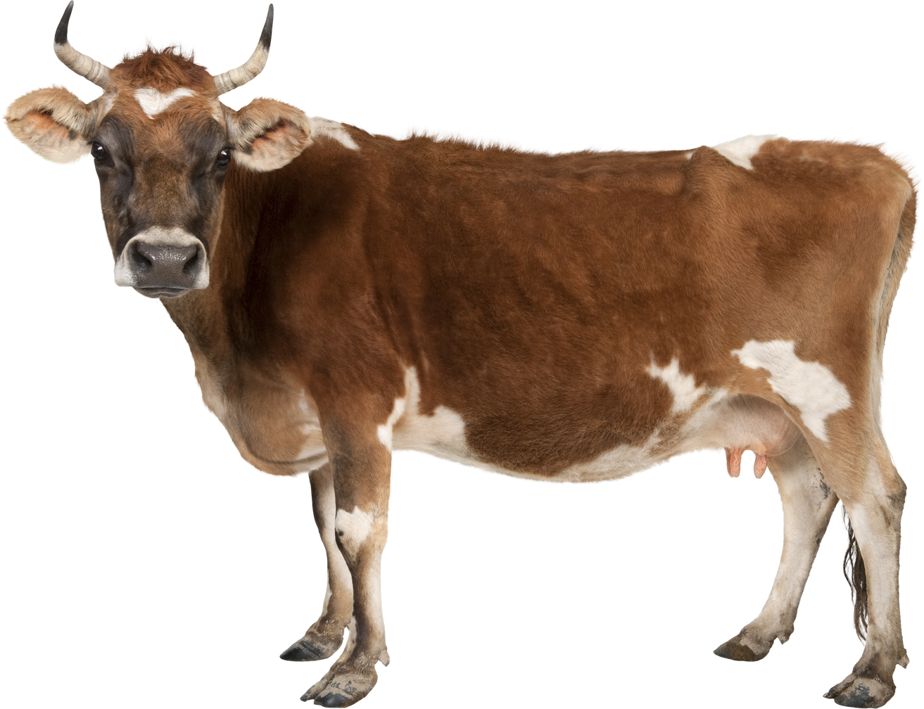
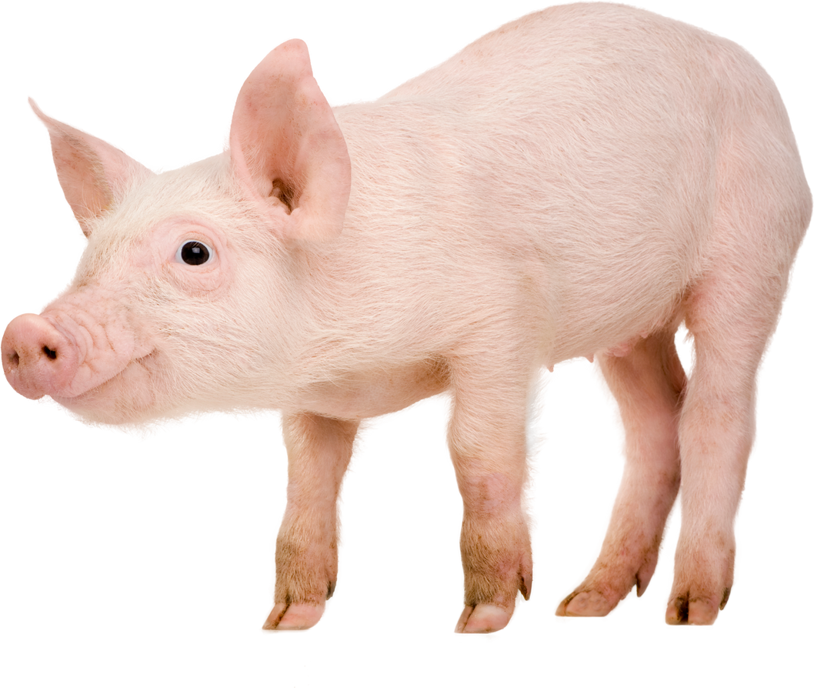
How often do you eat meat? (beef, pork, poultry)
Never
(vegan/vegetarian)
Fewer than 3 times/week
Every day
Record your score...

Slide 5
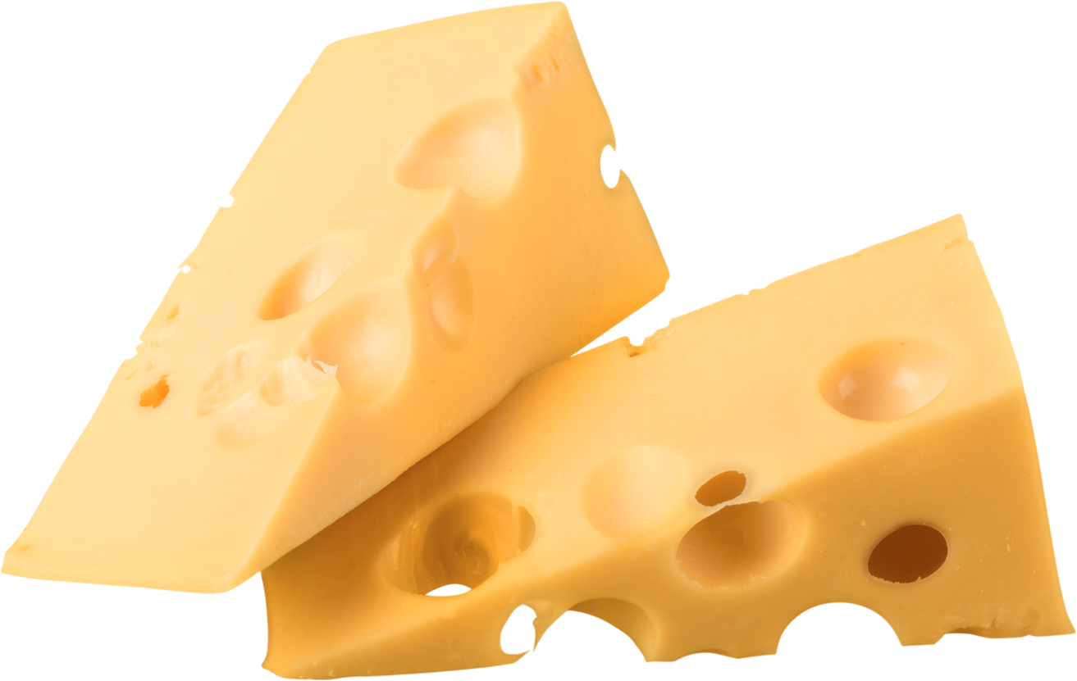
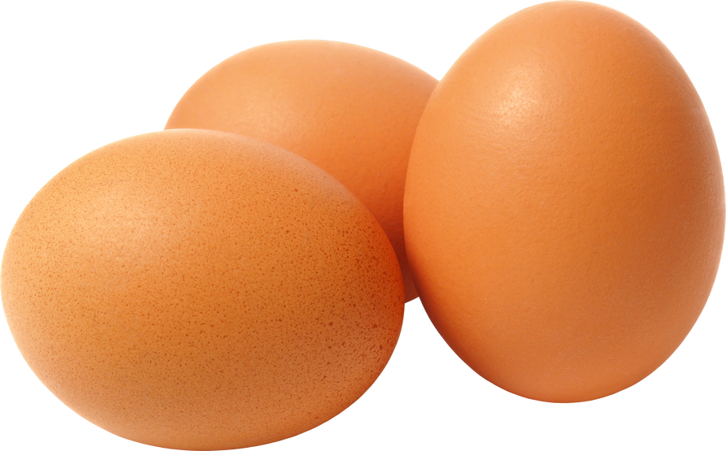

How often do you eat animal-based products? (eggs, dairy products)
Never
(vegan/vegetarian)
Fewer than 3 times/week
Every day
Record your score...

Slide 6
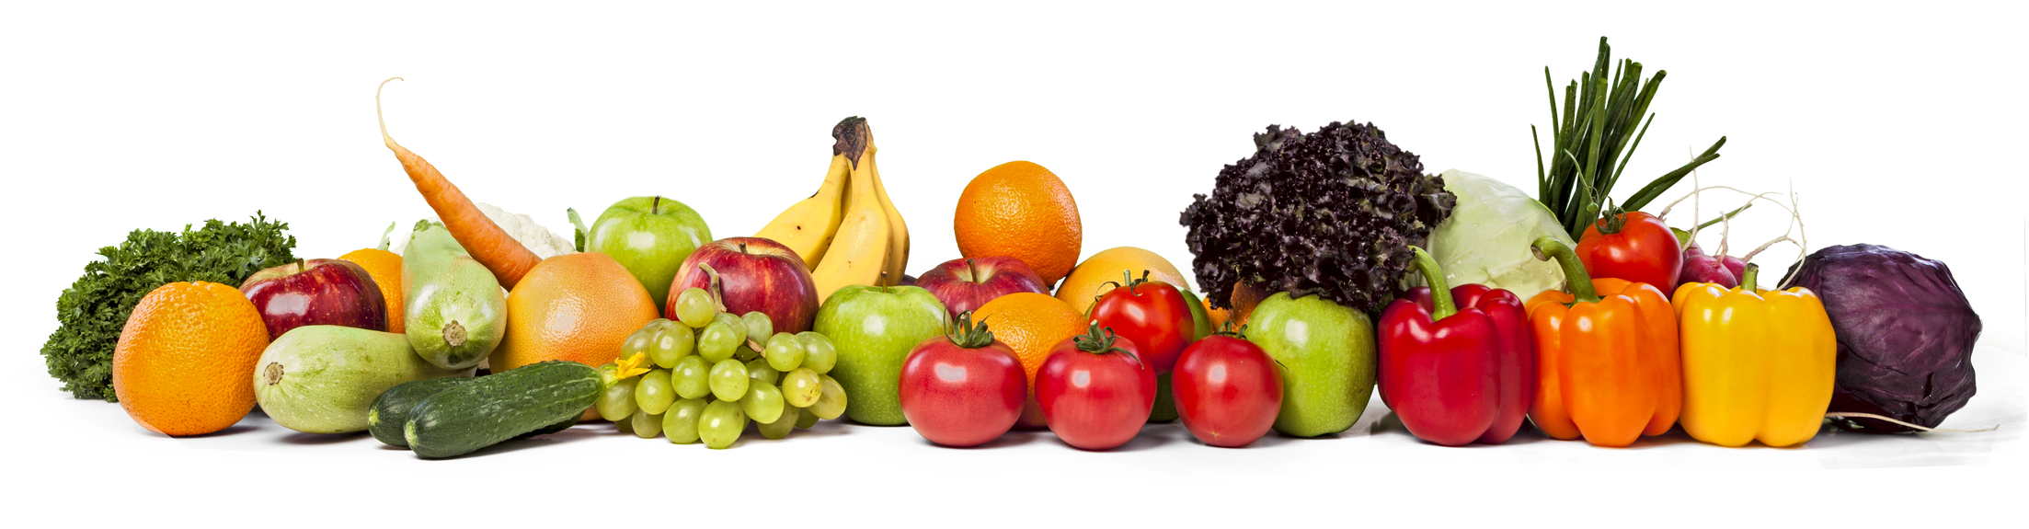
How often do you eat fruits and vegetables?
Never
Fewer than 3 times/week
Every day
Record your score...

Slide 7
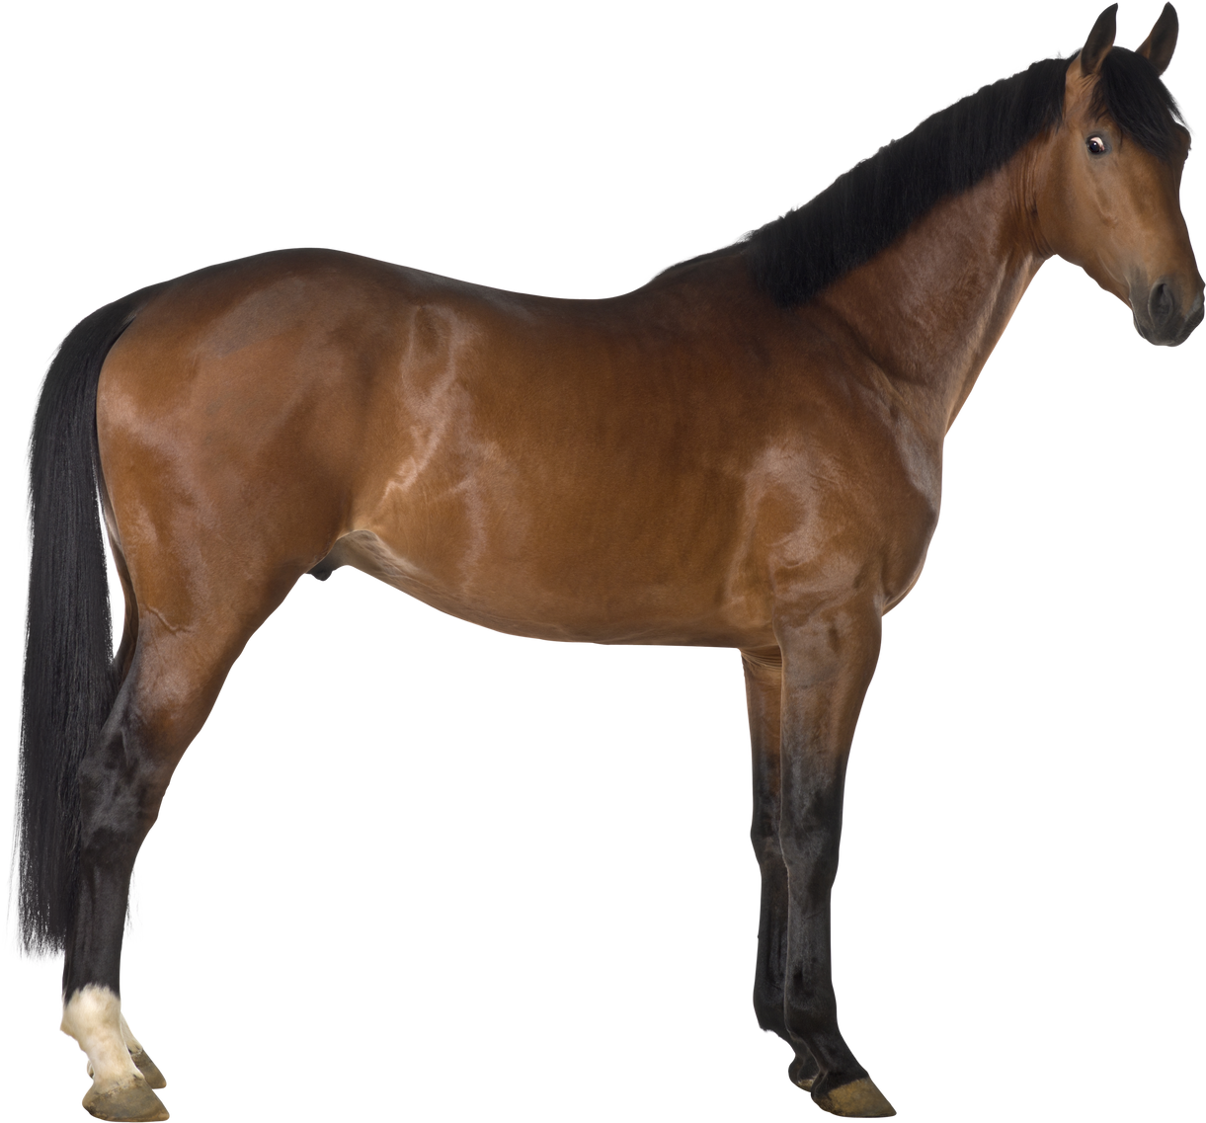
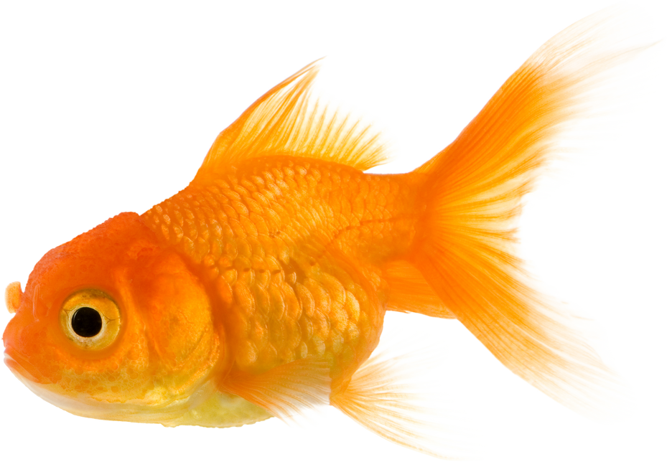
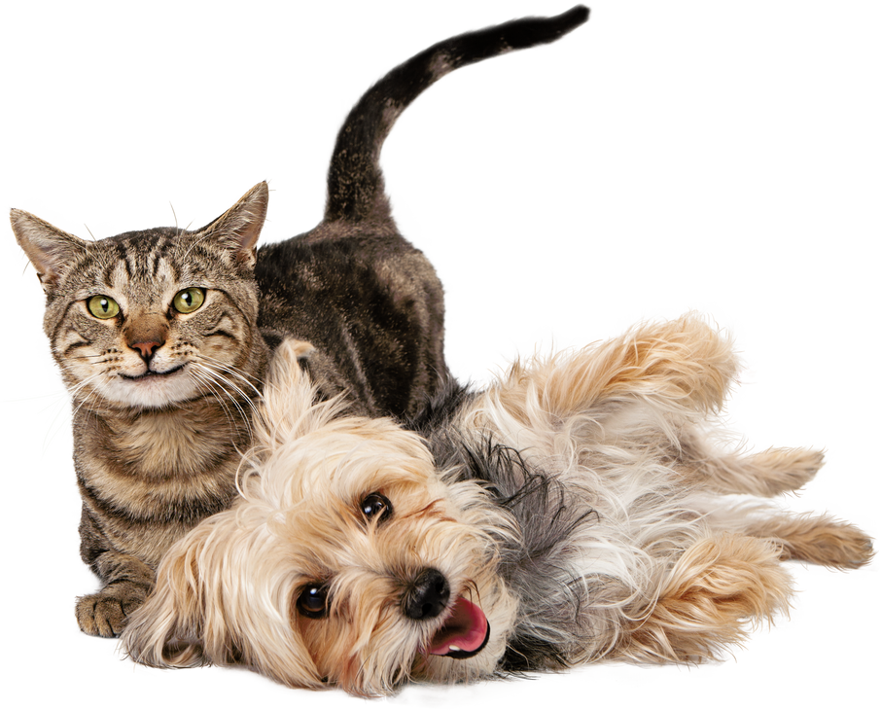
How many pets do you have?
Only large animals and/or multiple dogs/cats
None
One small
animal
1-3 dogs/cats
Record your score...

Slide 8
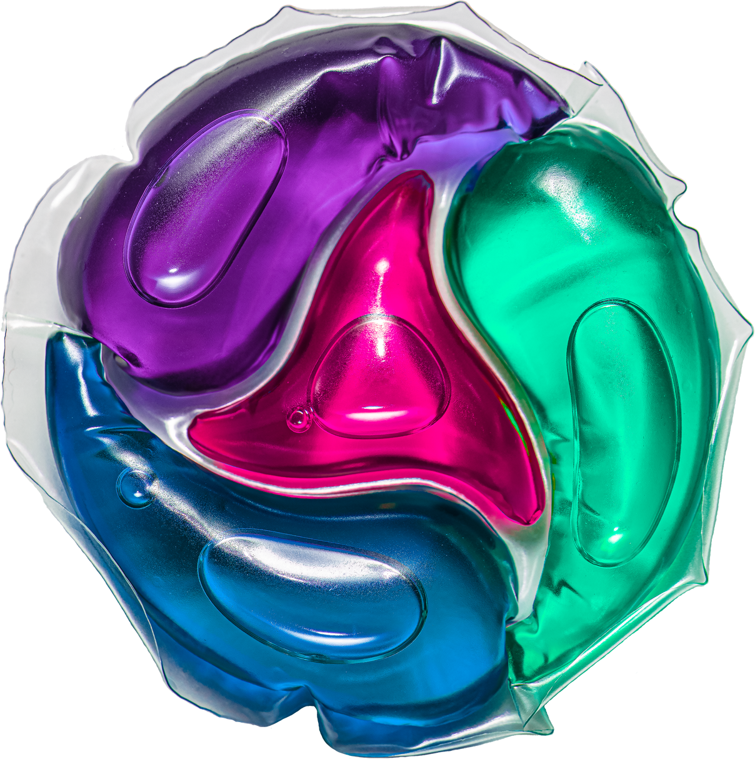
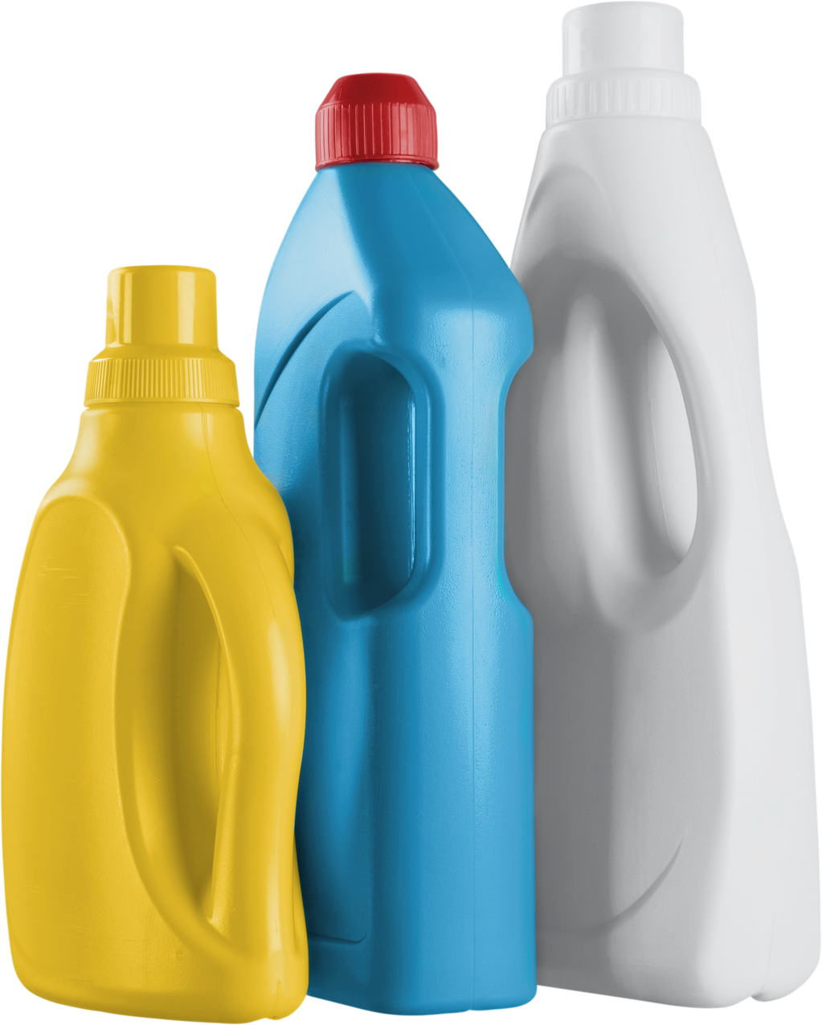
Do you wash clothes using Phosphorus-free laundry detergent?
P-free detergent
Unsure
if P-free
NOT P-free
Record your score...

Slide 9
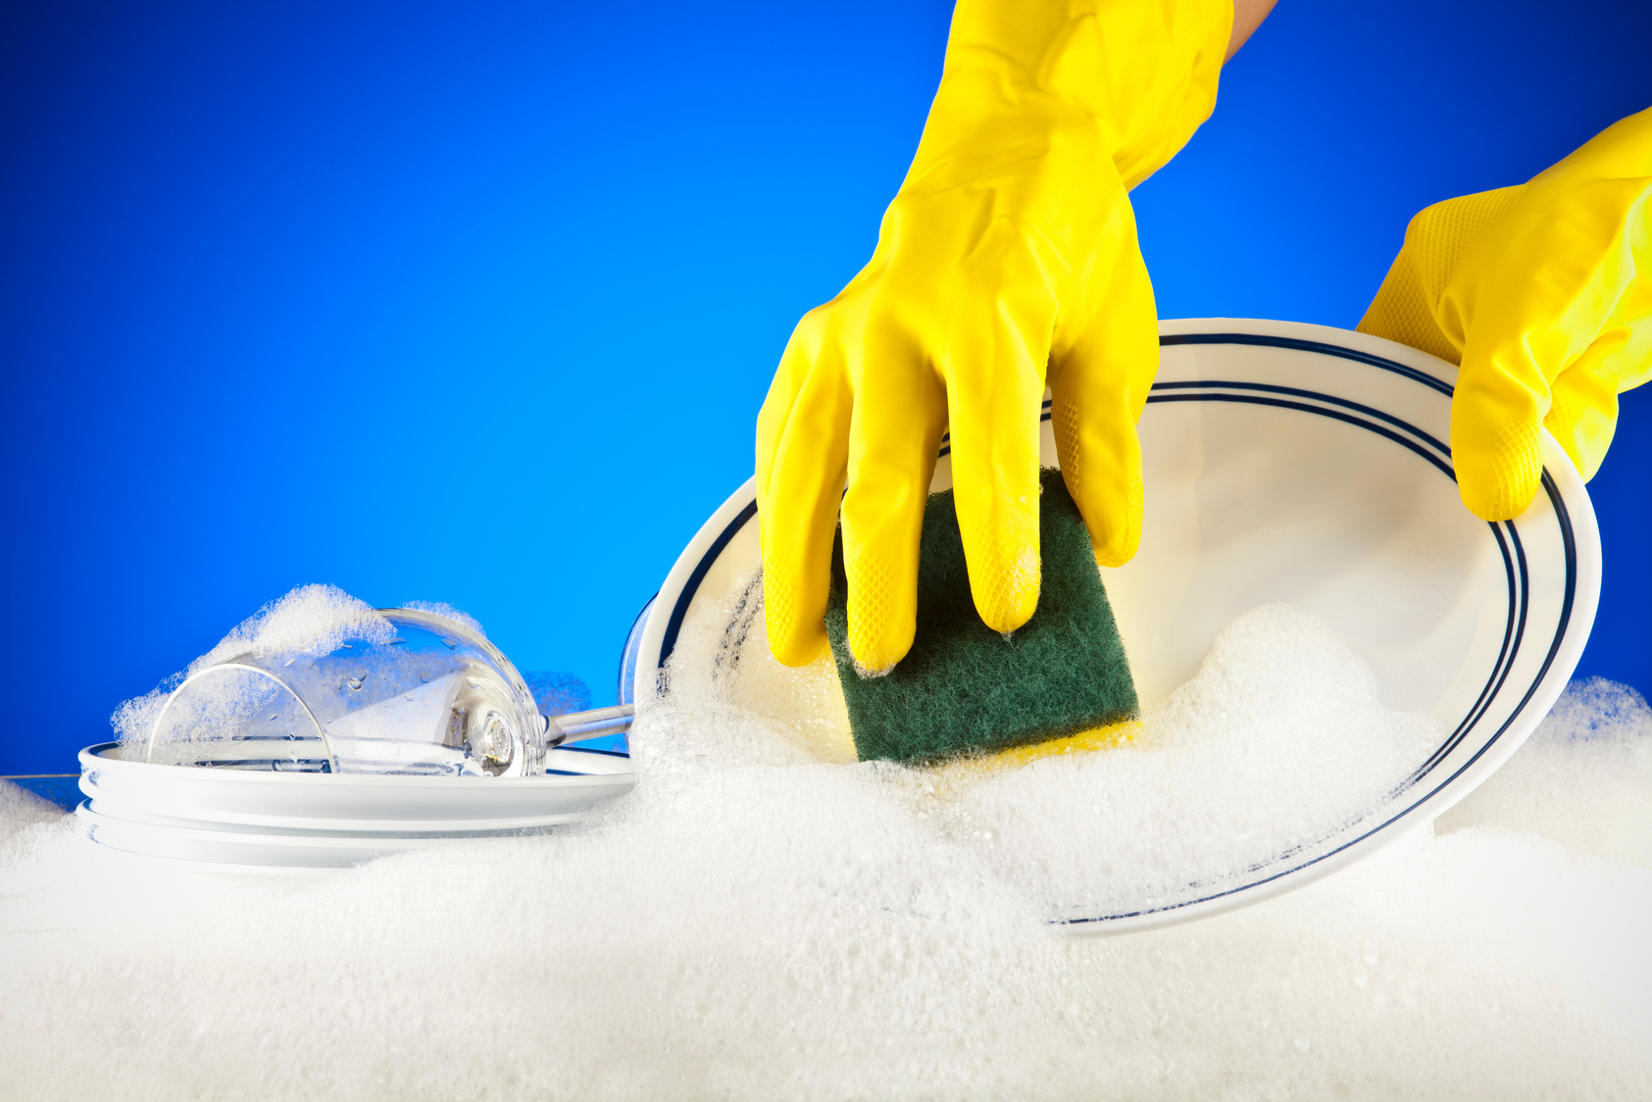
Do you wash dishes using Phosphorus-free dish soap?
P-free detergent
Unsure if P-free
Detergent has P
Record your score...

Slide 10
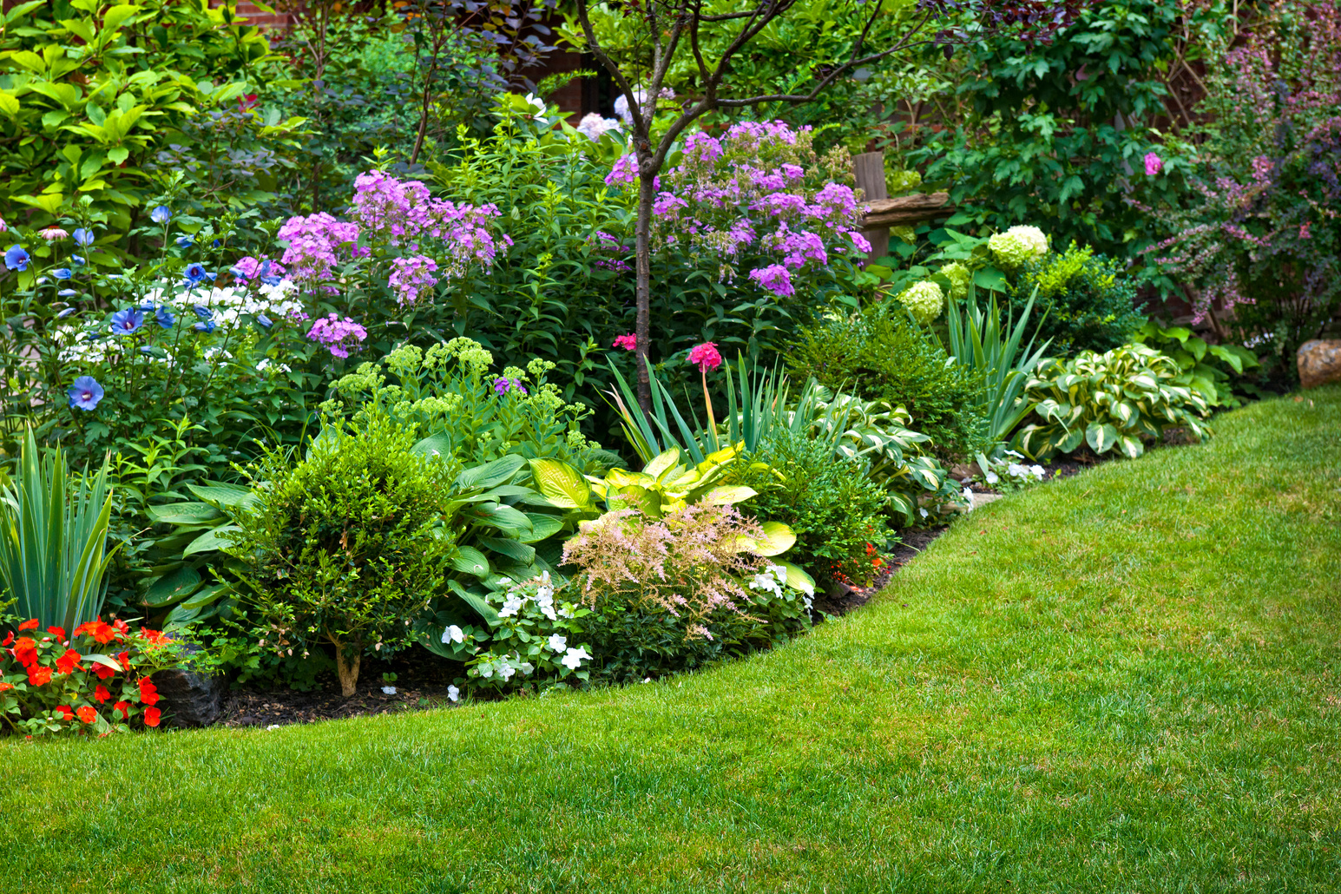
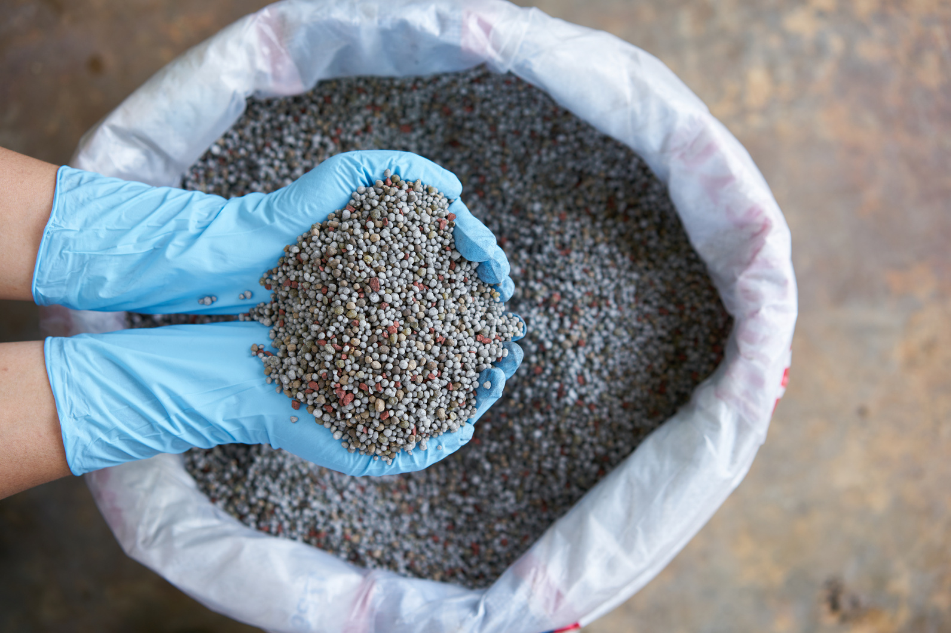
How often do you use fertilizer on your yard/plants?
Never
Once a year
Multiple times a year
Record your score...

Slide 11
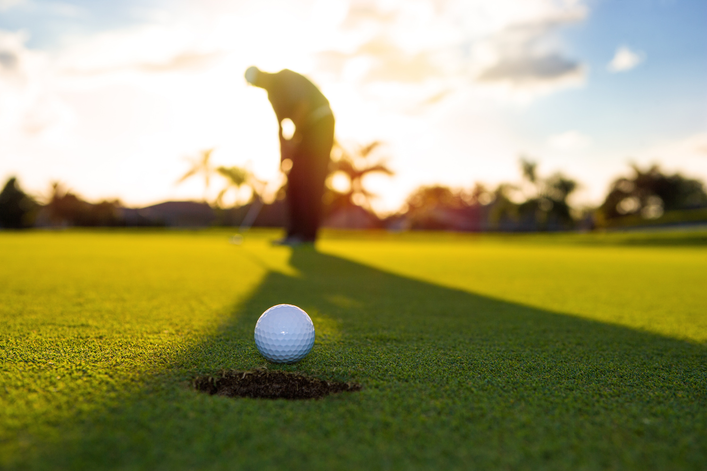
How often do you play golf?
Throughout
the year
Never
Once a year
Record your score...

Slide 12
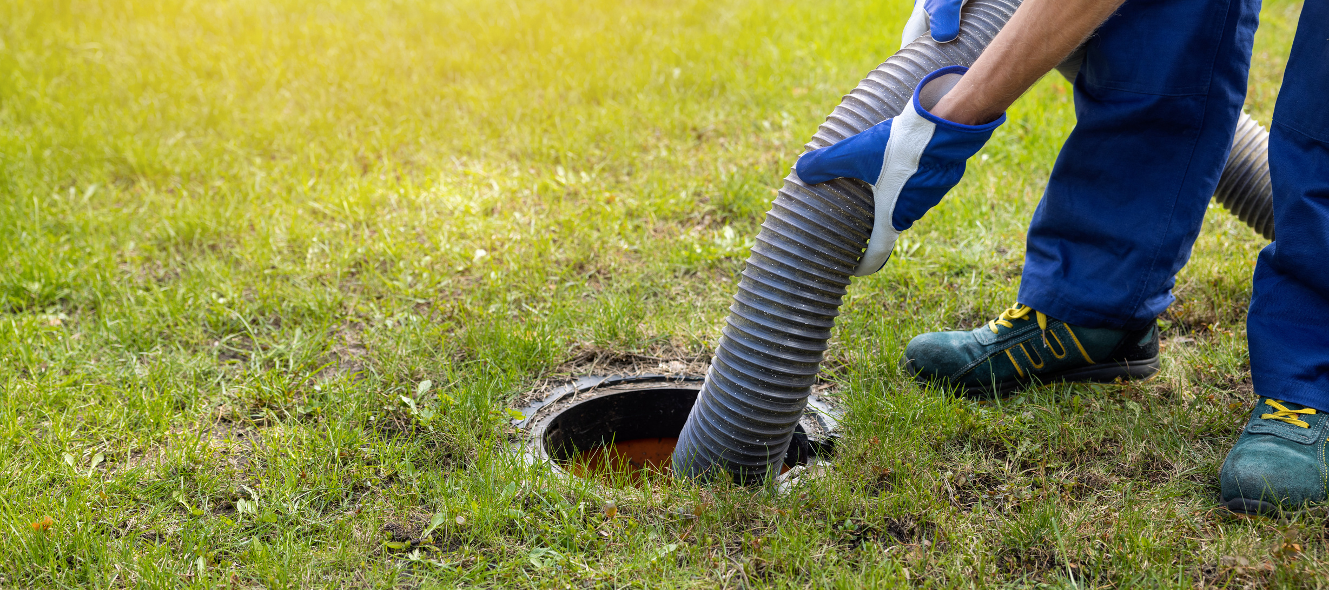
Septic System vs. Sewer System
NEW Septic
Tank
Septic Tank
(old or
not maintained)
Sewer Treatment
(city/town/public sewer)
Record your score...

Slide 13

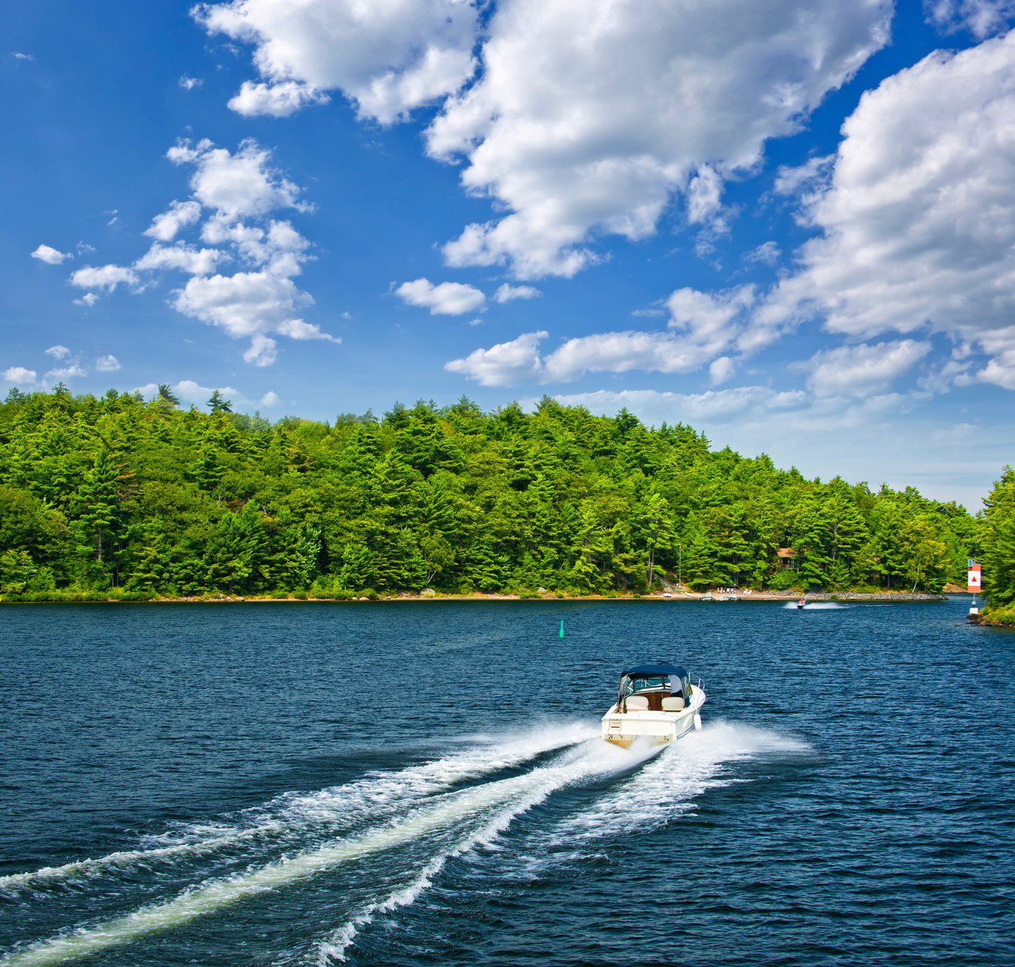
How often do you go boating?
Never
A few times
a year
Throughout
the year
Seldom
0
2
4
6
8
10
Less phosphorus
Most phosphorus
Record your score...

Slide 14



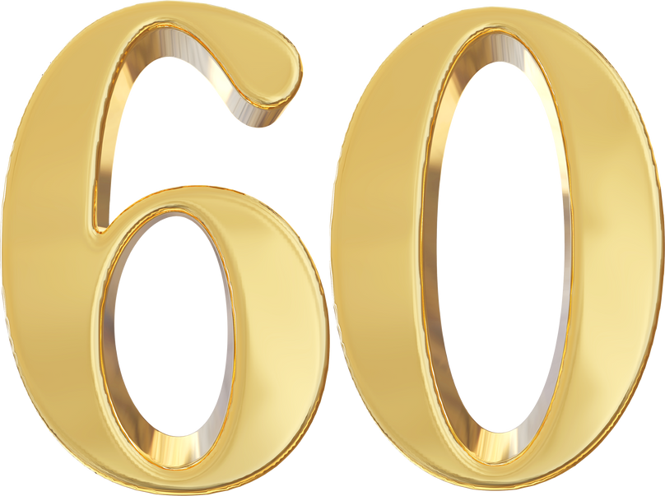



What’s your Phosphorus Footprint Score?
So much phosphorus! YIKES!
Still a high phosphorus score. What are two things you could change?
Doing OK! What is one thing you could change?
OK! What is one thing you could change?
WOW! This is a pretty great score!
You are a RockStar! Congrats! Don’t change a thing!

Slide 15
Let’s talk....
What does it mean to be organically grown?
How does that make a difference?
What if you eat vegetables/fruits that are heavily fertilized?
Does that make a difference?
Do you grow your own vegetables?
Are your detergents (dish and laundry) phosphate free?
How do you know?
What if you occasionally eat dairy products but they are cage free and not from a large facility?
What does that even mean?
Do you test your soil for nutrient levels?
Do you compost?
Do you pick up your dog poop every time?

Slide 16
Things to think about...
Phosphorus is used in farming for fertilizing crops for humans and farm animals.
Producing beef takes significant amounts of phosphate in fertilizer.
A plant-based diet helps reduce the amount of phosphate needed to feed the world.
Phosphorus is mined from rocks as a nonrenewable resource.
Can be extracted from mining but can also disperse into the environment (soil and bodies of water) by erosion.
Phosphorus contributes to the basic component of the building block for life and life’s processes (DNA and ATP).
Bones contain high levels of phosphorus and have historically been used for fertilizer.

Slide 17
Things to think about...
Phosphorus travels as runoff from farms, golf courses, ball fields, manicured lawns into bodies of water.
Excess phosphorus in waterways contributes to algae blooms and can cause fish kills.
Historically, phosphorus was a major component in all laundry and dish detergents until the last few decades.
Legislation is banning the use of phosphorus in detergents. Check out your products that you use in your home/work.
Phosphorus enters the environment after plants decay or animals produce wastes.
Dog poop (and yours) contains phosphorus. Dispose your pet’s waste to ensure no damaging runoff.

